Slide 1
Answers Space
1. Mars
2. Mercury
3. Ice and debris
4. 2
5. Gas
6. Neil Armstrong
7. Gravity
8. Milky Way
9. Jupiter
10. Titan

Slide 2
Mrs Halsall’s weekly quiz.
This weeks topic is…
Disney
Just for fun!
How many do you know?

Slide 3
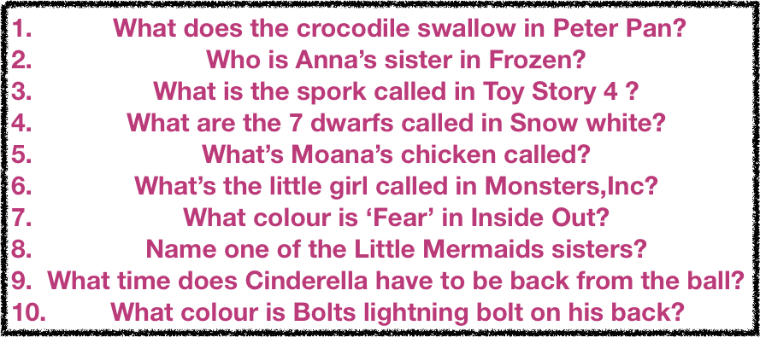
Questions on Disney

